Slide 1
Dr. Horticulture 1.0
By Cesar Reyes

Slide 2
Dr. Horticulture’s goals
Provide means of measuring nitrogen content of a plant by scanning its color
Prevent under and over fertilizing plants.
Reduce costs of fertilizers for farm owners.
Save the environment from pollution.

Slide 3
Dr. Horticulture’s problem
Image processing logic.
App’s interface layout.
Backend and database design.

Slide 4
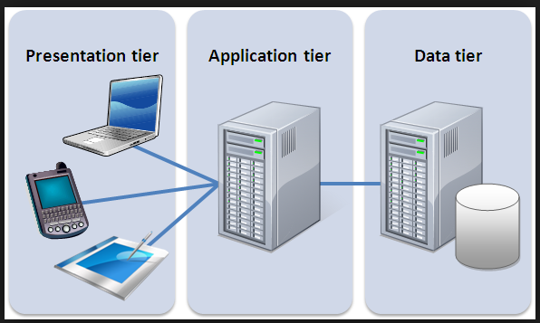
Solution to Backend and DB Design
MatLab for image processing.
Firebase for the database.
Python for interfacing
between MatLab and MySQL
and performing server logic.

Slide 5
Questions?

